Slide 1

Brainstorming Session: How to Boost Sales at Northwind
“Customers order different quantities when offered discounts.”
“The reps in London aren’t selling as much as the reps in the PNW.”
“Our customers seemed to buy more in 2013.”
“When we push beverages, we bring in more revenue.”
My task: to turn these claims into business insights by running experiments.
Will Graits

Slide 2
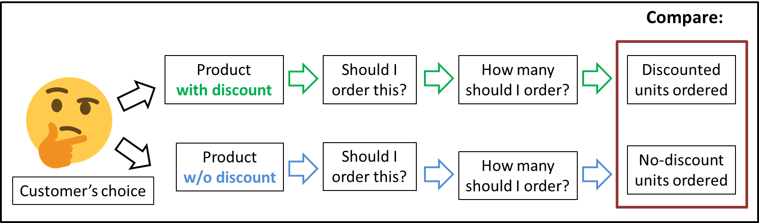
#1. “Customers order different quantities when offered discounts.”
Customer’s choices get compared.
Does discount have an effect on behavior?

Slide 3
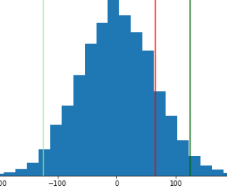
The result: In general, a customer doesn’t buy more or fewer units of a product when offered discounts.
Insight: Don’t change course at this time. Neither pushing nor removing discounts will boost sales.
Future work: Study customer behavior more.
Interactions with website?
Calls with sales reps?
The
“not-a-big-difference”
zone
Buys markedly less
Buys markedly more
Not too much more or less
Doesn’t buy any more or less

Slide 4



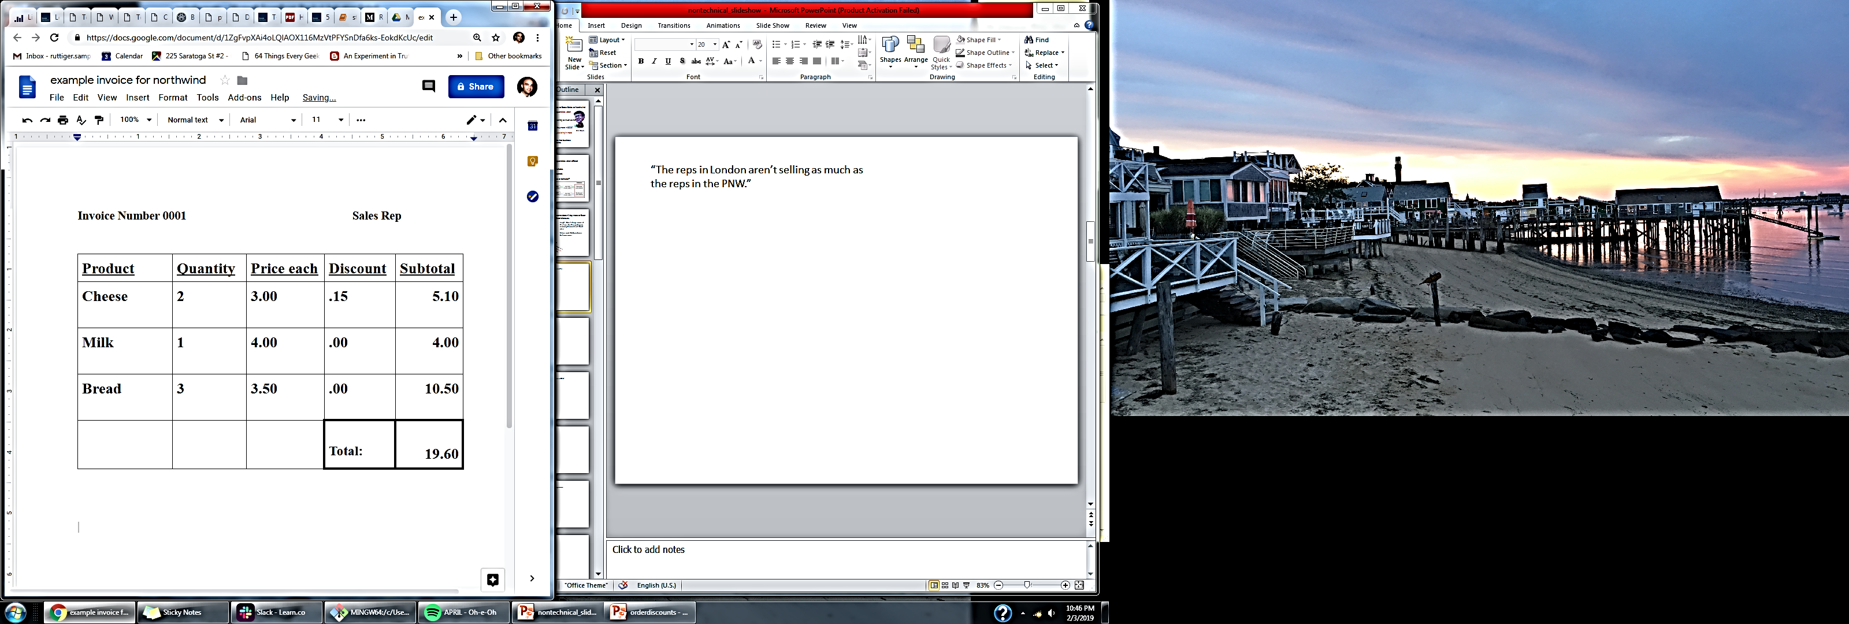
#2. “London reps aren’t selling as much as the PNW reps.”
Is the average London invoice total lower than PNW?

Slide 5
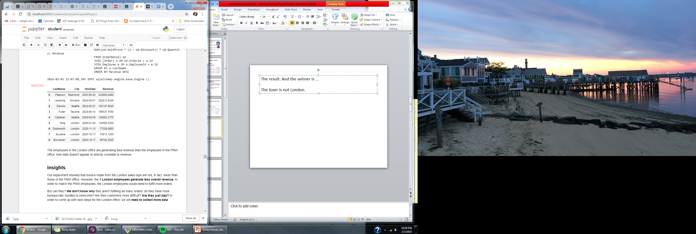
The result: And the winner is …
The loser is not London. Averages invoice totals are not lower.
However! London reps are generating less revenue overall.
Insight: Something else is going on.
Bureaucratic hurdles?
Sloth?
Future work: collect more data before scolding London.

Slide 6
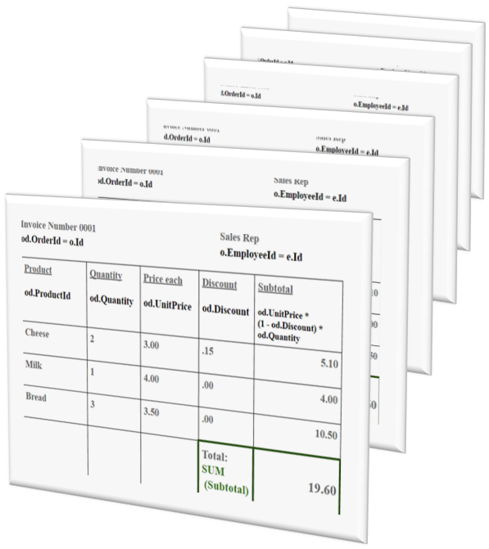
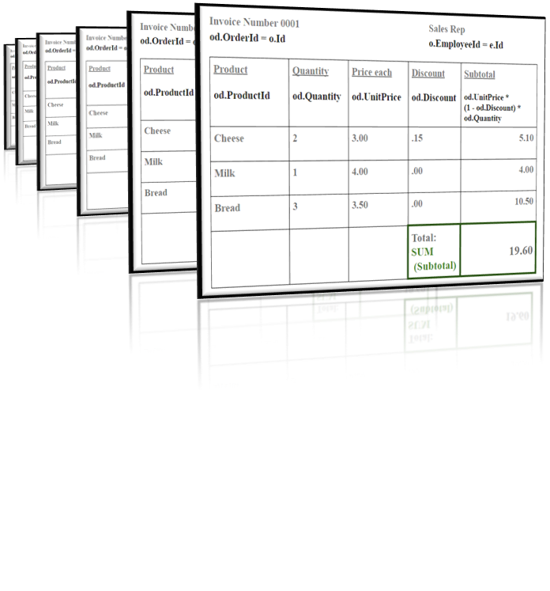
#3. “Customers seemed to buy more in 2013 than in 2014.”
Invoice totals will reveal a more specific change than gross revenue.
average 2013 invoice
average 2014 invoice

Slide 7
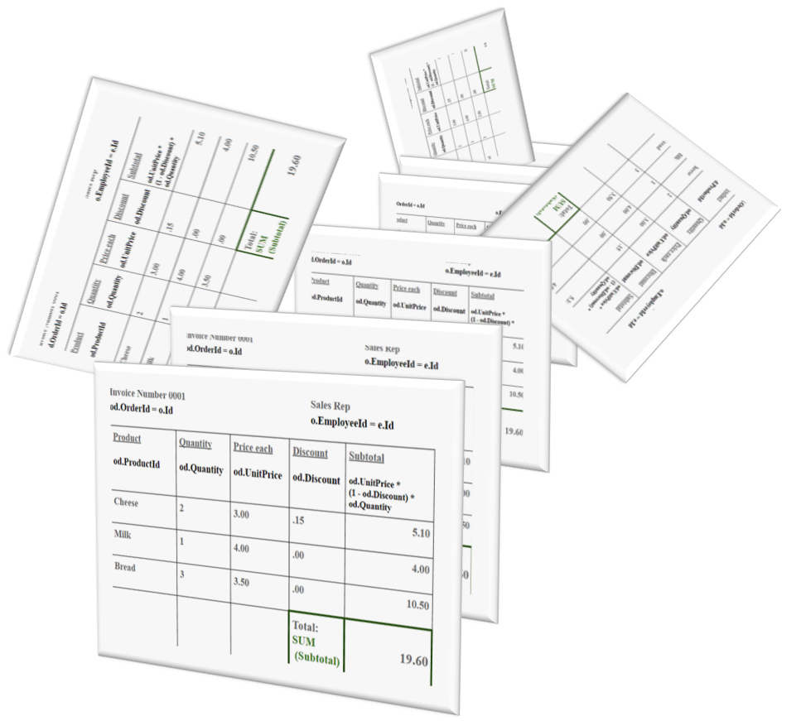
The result: Average totals were not higher in 2013.
Insight: Surprise!
Some invoices for 2014 are missing.
We can’t compare gross revenues until we track them down.

Slide 8
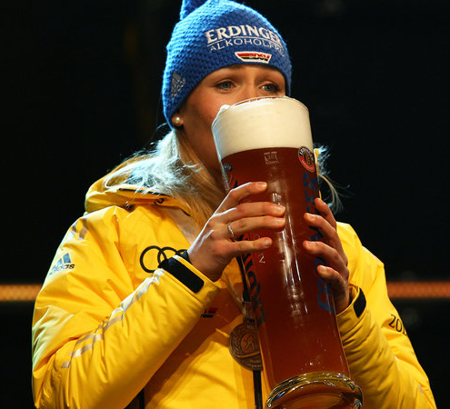
#4. “When we push beverages, we bring in more revenue.”
Taken for granted in food service.
Is it true?
If not true, might be annoying to customers.
Some reps do it, some don’t.
Compare invoices with beverages to invoices without.

Slide 9
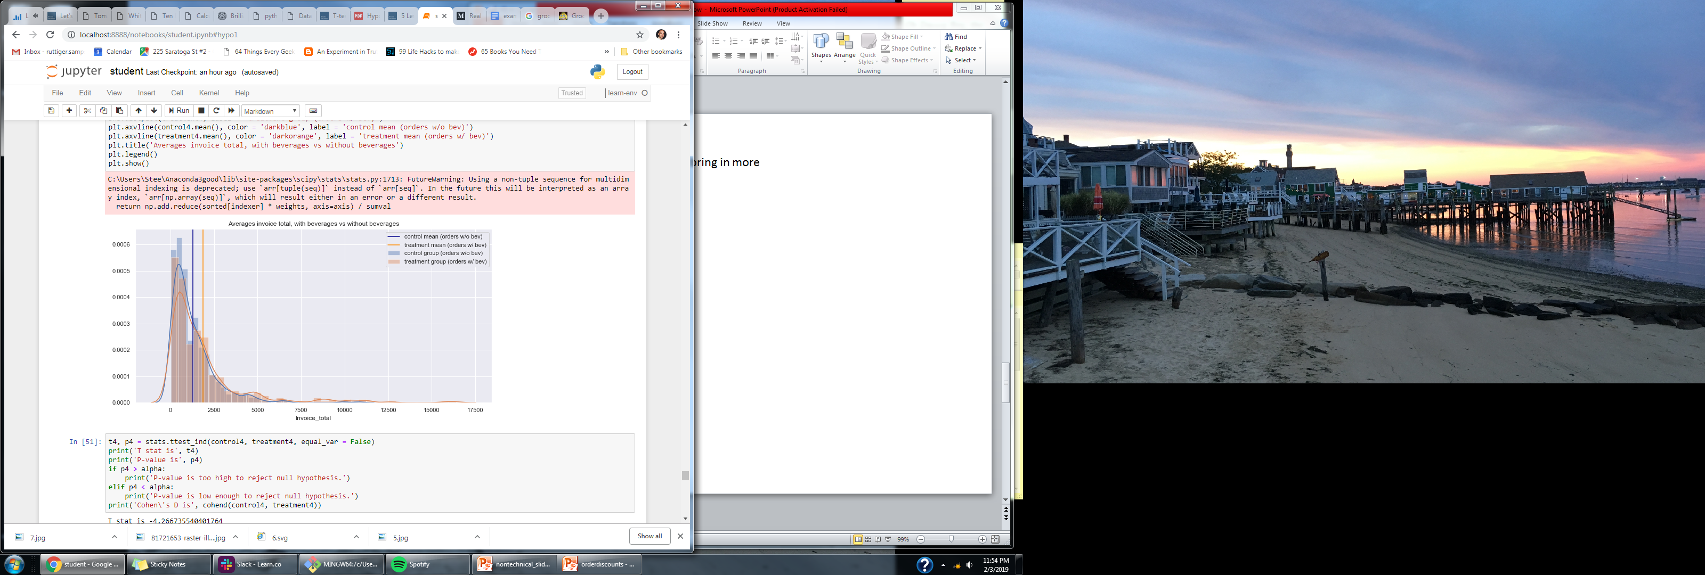
The result: Is it true? Yes!
Insight: Add the “beverage push” to best practices for sales reps.
Compare other categories, e.g. seafood and meat. “While you’re buying proteins…”
Average invoice total with bev
Average invoice total with bev

Slide 10
Summary
“Customers order different quantities when offered discounts.” No.
Don’t change course; research customer behavior more.
“The reps in London aren’t selling as much as the reps in the PNW.” No.
Research why London’s overall revenue is down.
“Our customers seemed to buy more in 2013.” No.
Find the missing data for 2014.
“When we push beverage, we bring in more revenue.” Yes.
Push the booze! Research other categories to push.

